Slide 1
TV REMOTE CONTROL JAMMER CIRCUIT
Presented by:
PA26- Piyush Pamnani
PA27- Ruchin Shroff

Slide 2
What is TV Remote Control Jammer circuit?
This circuit confuses the infra-red receiver in a TV. It produces a constant signal that interferes with the signal from a remote control and prevents the TV detecting a channel-change or any other command. This allows you to watch your own program without anyone changing the channel.

Slide 3
Components used in the circuit
+5v power supply
IR (Infra Red) LED (2 pieces)
555 Timer IC
220Ω, 1KΩ and10KΩ resistors
2N2222 transistor
100KΩ preset or pot
10nF or 22nF capacitor

Slide 4
What is 555 timer IC?
The 555 timer IC is an integrated circuit (chip) used in a variety of timer, delay, pulse generation, and oscillator applications. Derivatives provide two (556) or four (558) timing circuits in one package.

Slide 5
What is 100k Ω preset or pot?
The potentiometer, commonly referred to as a “pot”, is a three-terminal mechanically operated rotary analogue device which can be found and used in a large variety of electrical and electronic circuits. They are passive devices, meaning they do not require a power supply or additional circuitry in order to perform their basic linear or rotary position function.

Slide 6
Circuit Principle:
The idea behind the TV remote control jammer is sending a constant IR pulse with the carrier frequency of the transmitter. Hence, the result will be non-accepted signal from the receiver and therefore no action will be taken.
Basically the TV remote emits a sequence of pulses when you press a button. IR transmitter is fixed to the surface of the TV remote. This IR transmitter emits the pulses in unique configuration for each button.
IR receiver, which is arranged on the TV, will receive these sequence of pulses that are transmitted by the TV Remote and identifies which button is pressed in TV remote.

Slide 7
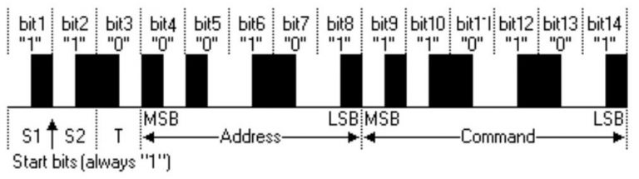
Generally Philips TV remotes follows RC5 (Remote Control) protocol. This protocol was developed by Philips in the late 1980s. According to this protocol, for each button, Remote transmits 14 bits. The below figure shows the frame format of RC5 protocol.

Slide 8
The first two pulses are start bits, and both are logic 1.
The 3rd bit is toggle bit. This bit toggled every time when a button is pressed or released. Using this bit, we can identify weather the button is pressed or not.
The next 5 bits represent the device address. Bit 4 is the MSB of the device address and bit 8 is the LSB of the device.
Last six bits in the frame format are command bits. These command bits varies for each button in the remote. Using these command bits, we can identify which button is pressed in IR remote.

Slide 9
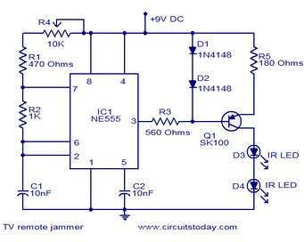
Circuit Diagram:

Slide 10
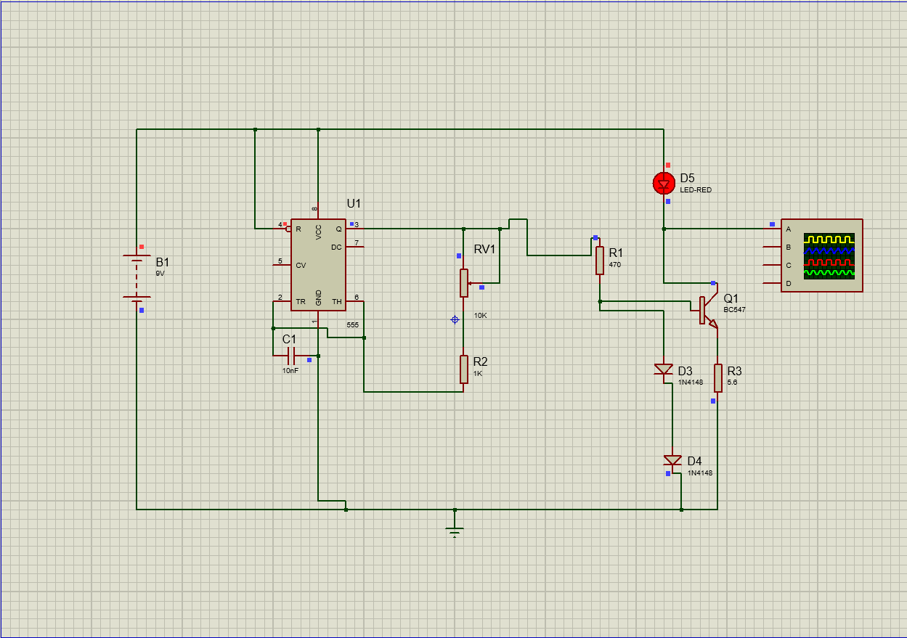
Simulation on Proteus:

Slide 11
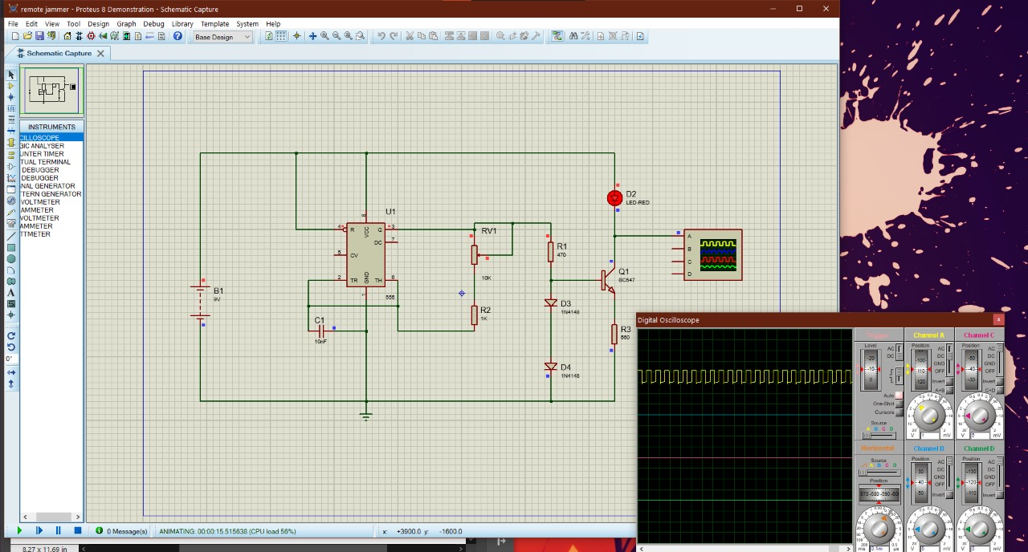
Output on Proteus:

Slide 12
Working of TV Remote Control Jammer
Connect 9V battery to the circuit.
Now adjust the pot 10KΩ to produce 38 KHz signal.
Now press the TV remote buttons.
You can observe that TV will not receive any commands from remote
Disconnect the battery from circuit and press TV remote buttons.
Now you can observe that TV will receive the commands from Remote

Slide 13
Working of TV Remote Control Jammer (continued)…
The concept of working of TV Remote Control Jammer is quite simple. When you press a button on a remote control for TV, stereo or other IR devices, it creates a series of pulses which the receiver in the target device, in this example, a TV, decodes into the corresponding function. This frequency is around 35.40 kHz. To confuse the receiver, this jammer sends out a steady stream of binary code (1’s and 0’s) at the same frequency, but contains no information to decode. The receiver basically sits there and does not respond at all and the real information cannot get through to it as long as the jammer is on Voila! You’ve jammed your TV remote.

Slide 14
Advantages:
We can use this circuit to jam the remote signals so that the other people cannot change the channel while watching our favourite program on TV.
It will not affect the signal receiving capacity of the TV.
Limitations:
The circuit should be tuned correctly to 38 KHz frequency to get accurate results.

Slide 15
References:
https://www.electronicshub.org/tv-remote-jammer-circuit/
https://circuitdigest.com/electronic-circuits/tv-remote-control-jammer-circuit

Slide 16
Thank You
I would like to express my special thanks of gratitude to our Professor Mr. Nathrao Jadhav , who gave us the golden opportunity to do this wonderful presentation on the topic: TV REMOTE CONTROL JAMMER CIRCUIT . This also helped us in doing a lot of research which in turn added to our knowledge and skills.
We would also like to thank each other who added great outlook on information and cumulatively we completed our presentation.

